Slide 1
Should-not-be-translated Text
Bin He
2014.11
Notes:
This is an uncompleted work, due to the time limit of my MSRA internship.

Slide 2
Outline
Motivation
Methods

Slide 3
Outline
Motivation
Methods

Slide 4
Translation Examples
Microsoft Windows is developed by Microsoft.
Bing: 微软的 Windows 是由微软开发的。
If translate: 微软的视窗是由微软开发的。
IBM manufactures and markets computer hardware and software.
Bing: IBM 生产和销售计算机硬件和软件。
If translate: 国际商用机器公司生产和销售计算机硬件和软件。
The central processing unit (CPU) is the brain of your computer.
Bing: 中央处理单元 (CPU) 是计算机的大脑。
If translate:中央处理单元 (中央处理单元) 是计算机的大脑。
Notes:
不该翻译且没有翻译的例子
无法理解
指代不明

Slide 5
Translation Examples
The new iPad is the third generation iPad.
Bing: 新的iPad是第三代iPad。
Suggestion: The new iPad是第三代iPad。
This is a picture of Samsung Galaxy Note.
Bing: 这是值得注意的是三星银河的图片。
Suggestion: 这是三星Galaxy Note的一张图片。
Google Play, formerly the Android Market, is a digital distribution platform operated by Google.
Bing: 谷歌播放，前身是安卓的市场，是由谷歌数字发行平台。
Suggestion: Google Play，前身是Android Market，是谷歌运营的一个数字发行平台。
Notes:
不该翻译的翻译了的例子

Slide 6
Problem and Definition
If translate some part of the text, it may bring some troubles to the readers:
Confused about the meaning of the text (无法理解)
Do not know the object described (指代不明)
Information redundancy (信息冗余)
Should-not-be-translated Text:
If the translation of a phrase in the source text will bring difficulties(confused about the meaning of the text or do not know the object described) in understanding the translated text or make information in the translated text redundant, we call the portion Should-not-be-translated Text.
Notes:
文本中的一部分内容翻译后会给读者理解上带来问题，或者造成翻译后的内容出现信息冗余，那么我们叫这部分内容为不应被翻译的文本。

Slide 7
Target
Identify Should-not-be-translated Text in a document
Improve the performance of machine translation

Slide 8
Outline
Motivation
Methods
Web text
Plain text

Slide 9
Outline
Motivation
Methods
Web text
Plain text

Slide 10
Should-not-be-translated text in Wikipedia
In the text:
code
mathematical function
phonetic symbols
abbreviation
out of vocabulary
…
Sections:
Languages
Notes
Footnotes
Literature
References
Further reading
External links
Bibliography
…
Rules
Notes:
内部文本中
大块

Slide 11
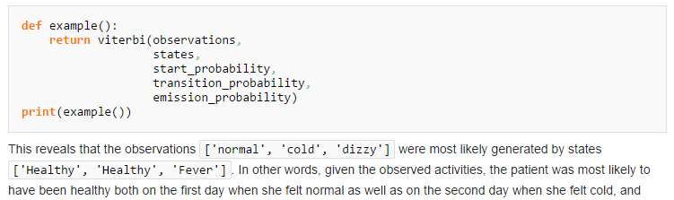
Code
Pattern:
<code>.+?</code>
<div class="mw-geshi mw-code mw-content-ltr" dir="ltr">\n<div class=[\s\S]+?</div>\n</div>

Slide 12
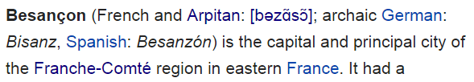
Phonetic symbols
Pattern:
English: <span class="nowrap"><span title="Representation in the International Phonetic Alphabet \(IPA\)" class="IPA">.+?/</a></span></span>
Other languages: <span title="Representation in the International Phonetic Alphabet \(IPA\)" class="IPA">.+?\]</a></span>

Slide 13
Abbreviation
DNA
IE 11
SR 62
Z15
…
Pattern (filter “A”):
[A-Z]+[ ]*\d*

Slide 14
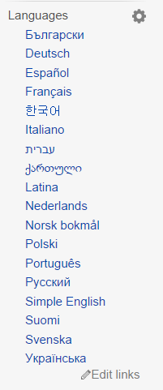
Languages
Pattern:
<li class="interlanguage-link[\s\S]*?<li class="uls-p-lang-dummy"><a href="#"></a></li>

Slide 15
Notes, Footnotes, Literature
Pattern:
<span class="mw-headline" id="Notes">[\s\S]*?</ol>
<span class="mw-headline" id="Footnotes">[\s\S]*?</ol>
<span class="mw-headline" id="Literature">[\s\S]*?</ul>

Slide 16
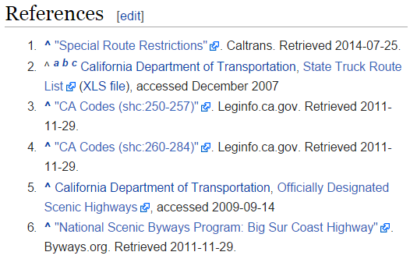
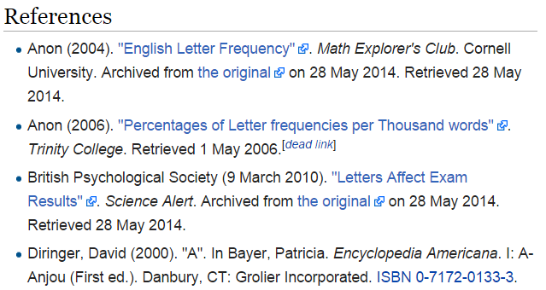
References
Pattern:
Ordered list: <span class="mw-headline" id="References">[\s\S]*?</ol>
Unordered list: <span class="mw-headline" id="References">[\s\S]*?</ul>(?!(\n<ul>))
Notes:
(?!(\n<ul>))：可能references里面存在多个无序列表，因此后面不能紧跟<ul>

Slide 17
Further reading, External links, Bibliography
Pattern:
<span class="mw-headline" id="Further_reading">[\s\S]*?</ul>
<span class="mw-headline" id="External_links">[\s\S]*?</ul>(?!(\n<h3>))
<span class="mw-headline" id="Bibliography">[\s\S]*?</ul>(?!(\n<h3>))

Slide 18
Outline
Motivation
Methods
Web text
Plain text

Slide 19
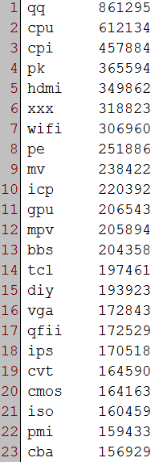
Abbreviation
Extract an English word list(wordlistC) from Chinese corpus, the word’s length is shorter than 5 but longer than 1.
Generate a word list(wordlistE) using English corpus
Remove the word in wordlistC whose frequency is large in wordlistE
Chinese sentences: 678,000,000+
English sentences: 179,000,000+
Filter number: Top 1610
Notes:
在纯文本中，首先要解决的是缩写。
从中文语料中抽取长度大于1，小于5的词，并用英文语料来过滤。

Slide 20
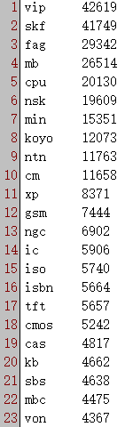
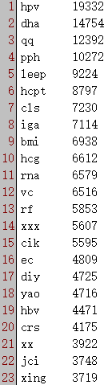
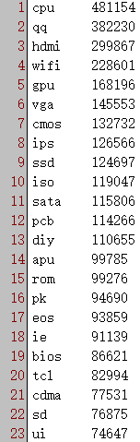
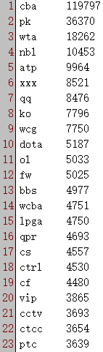
Baike
Health
SciAndTech
Sports

Slide 21
Translation Examples of phrase
Microsoft Windows is developed by Microsoft.
Bing: 微软的Windows是由微软开发的。
Microsoft Windows is a series of graphical interface operating systems developed, marketed, and sold by Microsoft.
Bing: 微软视窗是一系列的图形界面操作系统开发、销售，并由微软出售。
Suggestion:微软Windows是一系列的图形界面操作系统，由微软开发、推向市场并出售。

Slide 22
Translation Examples
You can use Office 2010 to finish your work..
Bing: 您可以使用Office 2010 来完成你的工作。
You can use Office 2013 to finish your work.
Bing: 您可以使用办公室2013年来完成你的工作。
Suggestion:您可以使用Office 2013年来完成你的工作。

Slide 23
Analysis
Do-not-translate reasons of MT system:
MT system do not know how to translate. (out of vocabulary)
In the training corpus, the bilingual pair keep the phrase untranslated, i.e. a phrase will not be translated after training when it is in some kind of context.
Translation reasons of the previous examples:
Training corpus does not contain a sample of the phrase untranslated or in the corresponding context untranslated
Training corpus contains a few samples of the phrase untranslated or in the corresponding context untranslated
Complement the samples
Notes:
短语不翻译或者处于某上下文时不翻译的样例
样例很少
我们想到了是不是可以在训练语料中补充这样的样例？

Slide 24
Solutions
Complement the training samples
Train a Should-not-be-translated phrase identifier

Slide 25
Solutions
Complement the training samples
Train a Should-not-be-translated phrase identifier

Slide 26
How to complement the samples
First phase:
extract untranslated phrase from bilingual corpus and generate a list (BiUphraseList) contains the phrase and its frequency.
Second phase:
extract English phrase from Chinese corpus and generate a list (EpCcontextList) contains the phrase, its Chinese context(±2) and the corresponding frequency.
Third phase:
use EpCcontextList to complement the samples of the phrase whose frequency is low in BiUphraseList, generate a list (EpEcontextList) contains the phrase, its English context(±2) and the corresponding frequency.

Slide 27
Third phase
Step 1:
pick out a phrase whose frequency is lower than Number1 from BiUphraseList, if can not, End.
Step 2:
search for the phrase in EpCcontextList, if exists and its frequency is larger than Number2, get the phrase and its Chinese context, CcontextList; else return Step 1.
Step 3:
search the phrase in English corpus, generate an English sentence list(EsentenceList) that each sentence contains the phrase.
Step 4:
translate the sentences in EsentenceList into Chinese, generate a Chinese sentence list, CsentenceList.
Step 5:
pick out a sentence from CsentenceList and tokenize, if the sentence contains the ±2 words of any context of CcontextList, add the phrase and its ±2 words in the corresponding English sentence into an English context list(EcontextList), repeat Step 5 until CsentenceList is empty.
Step 6:
add the phrase and its EcontextList into a list, EpEcontextList, return Step 1.
Notes:
if the sentence contains the ±2 words of any context of the phrase in EpCcontextList
这个条件需要调整，尝试中。。。
有一个动词一样；
有一个词（汉字）一样（相关）

Slide 28
Flowchart of third phase

Slide 29
English phrase English context list
EpEcontextList
No corresponding correct Chinese context
Can not be used in the training corpus of MT system
Preprocessing module of MT system
A classifier which can identify the should-not-be-translated phrase
Notes:
在抽出这些英文短语的上下文后，由于没有准确的中文的上下文，我们就利用这些英文短语训练一个分类器，在进行机器翻译之前作为预处理，用来标记出不翻译的短语。

Slide 30
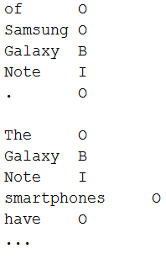
Train a classifier using EpEcontextList
Phrase
Galaxy Note
Context List
of Samsung Galaxy Note . (This is a picture of Samsung Galaxy Note.)
The Galaxy Note smartphones have (The Galaxy Note smartphones have been considered the first commercially successful examples of phablets.)
…

Slide 31
Train a classifier using EpEcontextList
Model
CRF model
Features
Lexical features
Target word
Lexical bigram before and after target word
…
Orthographic features
Number
Word length
Punctuation
…

Slide 32
Solutions
Complement the training samples
Train a Should-not-be-translated phrase identifier

Slide 33
Identify Should-not-be-translated phrase
Corpus: Bilingual corpus on Tech domain
Sentence number: 2623709
Training data/Testing data = 3:1
Much larger Chinese corpus and English corpus

Slide 34
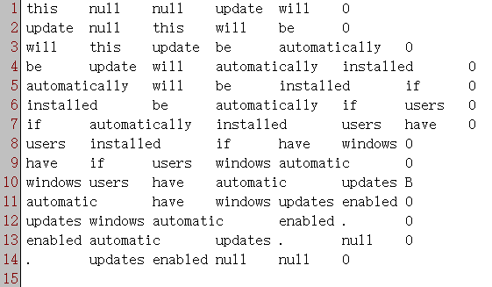
Train a identifier
Training data:
Model
CRF model
Features
Lexical features
Word[-2]
Word[-1]
Word[0]
Word[1]
Word[2]
Words[-1:0]
Words[0:1]
Words[-2:0]
Words[0:2]

Slide 35
Evaluation
System identification | 129773
Golden standard | 138366
Matched number | 118510
Precision | 0.91320999
Recall | 0.856496538
F-measure | 0.883944521
Notes:
Need a manually labeled gold standard to evaluate the real F-measure.

Slide 36
Evaluation on MT
To be continued

